Slide 1
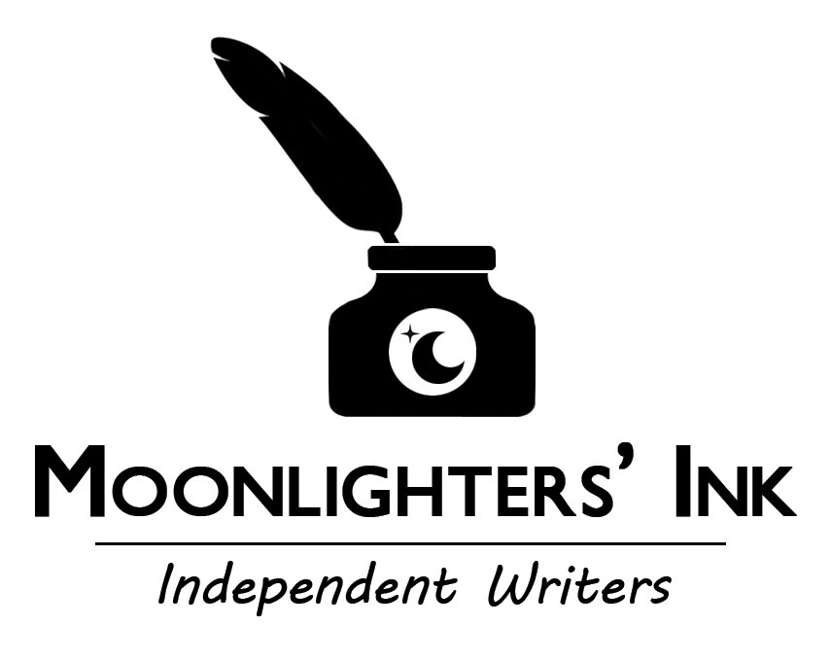
Steve Manchester
Figuring Out Your Strengths as a Writer

Slide 2
The Real Questions
The first step in figuring out your strengths as a writer is to understand what inspires you as a writer. For me, it’s my children, my wife, my family, and the thoughts and feelings I want to share with them—the things in my life that evoke the most emotion and passion.
To discover your true inspiration—your muse—ask yourself two simple questions:
  What do I really want to write about?
  If I were writing only for myself, what would I write?
Once you have the answers to these, follow it up with an honest assessment:
  How comfortable (and skilled) am I with this sort of writing?

Slide 3
Read
  Becoming a voracious reader does several things: it increases your vocabulary, it offers you an ongoing class on writing (and how other professionals apply their craft), and so on.
  The more you read, the easier it is to make an honest assessment of where you stand amongst those who write within the same genre(s). It’s hard to know where your work fits unless you know what your competition is out there in the market.
  FRIENDLY REMINDER: While I’m in the process of writing, I guard against becoming unwittingly impressed by certain passages or word usages from another writer that may catch my fancy.
  When it’s all said and done, reading helps you find your writing strengths through recognition of what you already possess, as well as areas that need improvement—or more focused training—on your part.

Slide 4
Storyboard
  Plot lines, character development and scene setting should all be fleshed out in the outlining process. Creating a detailed storyboard actually frees you up to write—really go at it—without wondering or worrying where your story needs to go next. The storyboard is merely a road map.
  As a benefit of storyboarding, you’ll be able to identify your writing strengths (as well as your weaknesses) during the process; it isn’t difficult to determine what comes easy to you and what requires much more time and effort. In fact, these truths may jump right out at you from the written outline.

Slide 5
Write
The trick to finding your true style: Most writers love to pen what they love to read. If you hate horror stories, then don’t write them. If you don’t enjoy a good mystery, then you probably shouldn’t be creating one. Again, write what you feel passionate about, what excites you.
As much as it is a craft or a passion, writing is also a discipline that requires training just like any other. Write every day, or at least schedule time dedicated to your writing. Eventually, you’ll learn to write even when you don’t want to, which is an important trait toward becoming both prolific and professional. True strength comes from training—and discipline.
Forgive the three clichés below, but before finding your writing strengths you must ensure that you’re employing several basic writing principles: Show, Don’t Tell * Familiar Material * Less Is More

Slide 6
Edit
Whenever I complete the first draft of a new novel—and go through it twice with my editor’s hat on—I place the manuscript in the bottom drawer of my desk and leave it alone for at least three to four weeks. When I return to it, it always reads much differently than I remember—highlighting the holes (or weaknesses) in the writing.
The back and forth process between you and your trusted editor will undoubtedly highlight the strengths (and weaknesses) within your writing. There’s only a few things you need to have in place for this magic to occur:
Your editor should be someone who enjoys your work, but can still prove honest and critical; someone better at the mechanics of writing than you are, but who is not simply feeding his or her ego. Once real trust is established—and you absolutely need to trust this person, while surrendering to the process—there is no better stage to discover what your writing strengths (as well as weaknesses) are. appreciate your style or voice, how can they help better your work?

Slide 7
Solicit Feedback
Solicit legitimate, objective book reviewers and bloggers to read and critique your work. Sorry, but moms and boyfriends do not count. Being able to measure the strengths and weaknesses is so important. Objective reviewers have no qualms about pointing out deficiencies in your work, or areas that require more focus and effort. Fortunately, they’re also honest about the things they liked—undoubtedly, your strengths.
Internalize their honest feedback; you may not like what they have to say or even agree with it, but you do need to consider it—and apply it—toward your next rewrite and future writings.

Slide 8
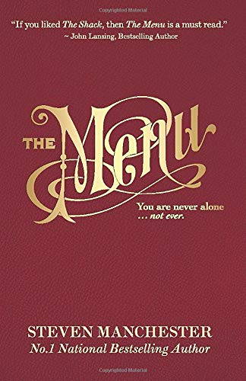
Write…
Write…
Write!
Connect with me on FB & Twitter

