Slide 1
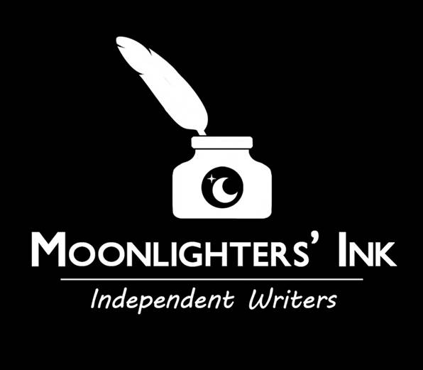
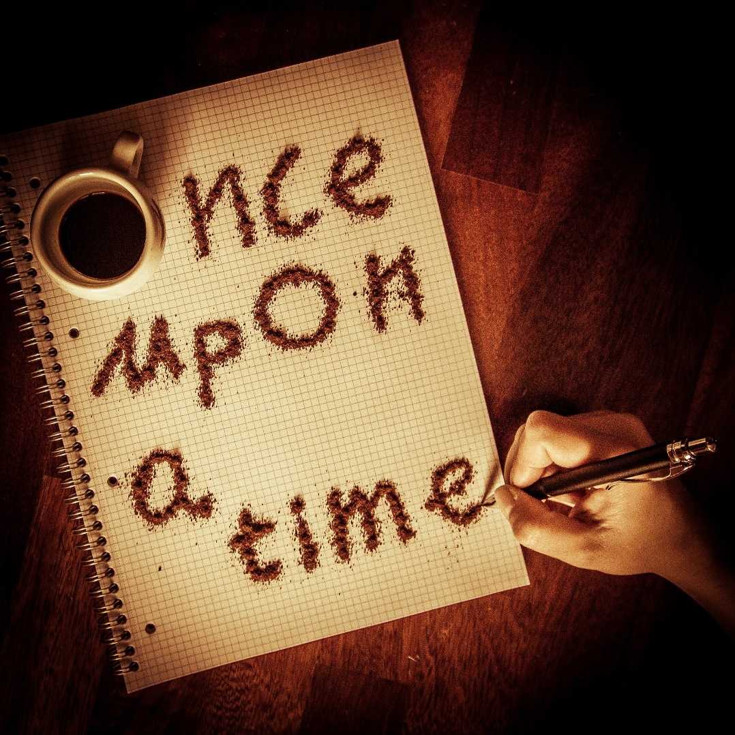
Story Craft:
Structure

Slide 2
Common Features of Stories
A central figure whose fate is the focus of the story.
A world, imaginary or real, which this figure inhabits.
Something happens to summon or propel this figure into a state of action that will transform their lives.
This action will involve conflict and uncertainty (i.e., a villain), which will result in a climax where all seems lost,
until the action is resolved in a catastrophe (an unhappy ending)
or an unknotting of the tangle of conflict (a happy ending) (i.e., frustration or liberation, death or renewal) .
[Christopher Booker, The Seven Basic Plots: Why We Tell Stories (London: Bloomsbury Continuum, 2004), 17-19)

Slide 3
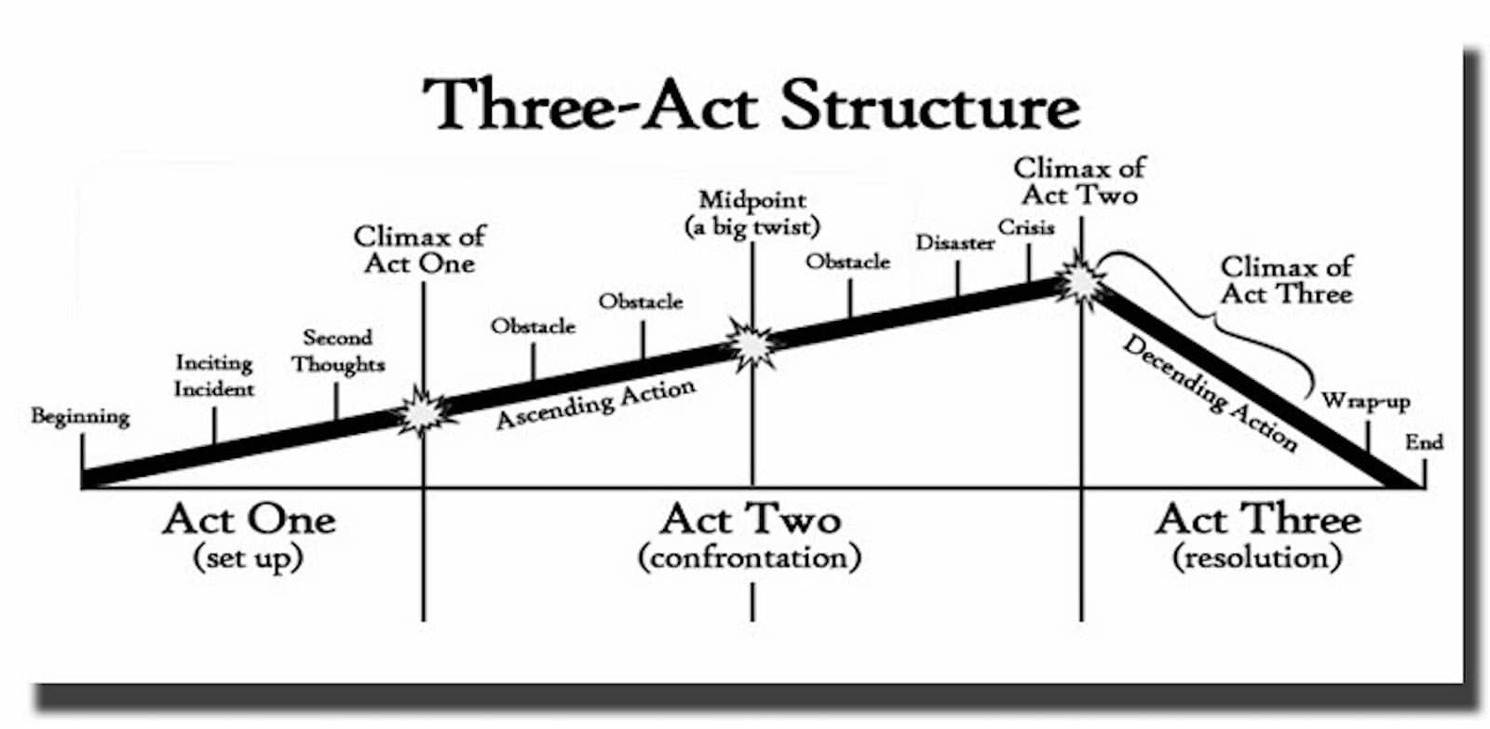
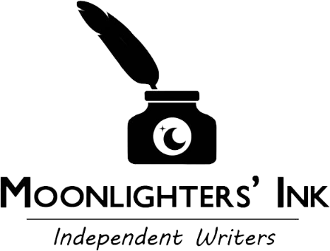
Chart taken from https://www.studiobinder.com/blog/three-act-structure/

Slide 4
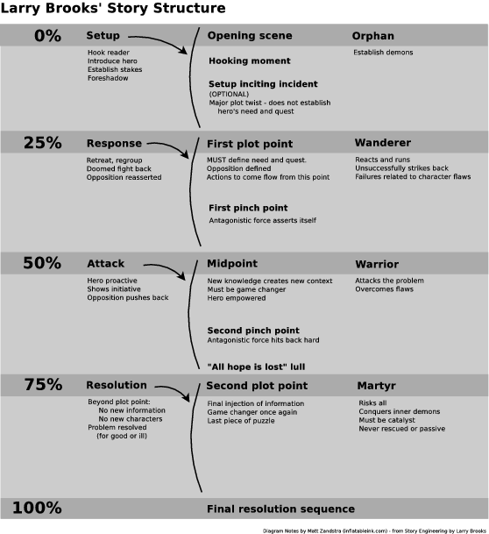
Four-Act Structure
Act 1
Act 2
Act 3
Larry Brooks, Story Engineering: Mastering the Six Core Competencies of Successful Writing (Cincinnati, Ohio: Writer’s Digest Books, 2011), 139-157.
Act 4
Chart taken from https://inflatablepress.com/larry-brooks-story-structure/

Slide 5
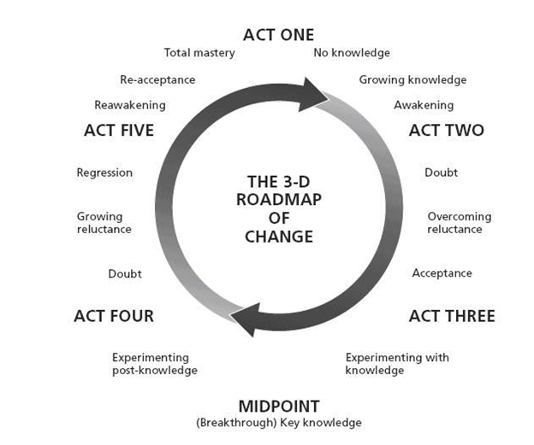
Five-Act Structure
John Yorke,
Into the Woods: A Five-Act Journey Into Story (NY: Harry N. Abrams, 2015), 51.

Slide 6
Dan Wells, Seven-Point Story Structure
Hook — Your character’s starting point. This is the opposite of the Resolution.
Plot turn 1 — The event that sets your story in motion and moves you from the beginning to the Midpoint. You introduce the conflict, and your character’s world changes. This is basically when your character sets out on their journey.
Pinch point 1 — This is where you apply pressure. This is often used to introduce the antagonist.
Midpoint — Your character moves from reaction to action. They determine they must do something to stop the antagonist.
Pinch point 2 — This is where you apply more pressure. Your story takes the ultimate dive. Your character is at their darkest moment. They have lost everything.
Plot turn 2 — Here, you move the story from Midpoint to the end, the Resolution. Your character gets or realizes that they have the final piece of information to achieve what they set out to do in the Midpoint.
Resolution — This is the climax of your story. Everything in the story leads to this moment. Here, your character achieves (or fails to achieve) what they set out to do.
https://youtu.be/KcmiqQ9NpPE (https://livingwriter.com/blog/dan-wells-seven-point-story-structure)

Slide 7
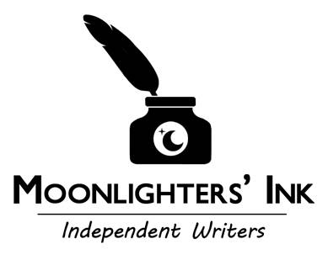
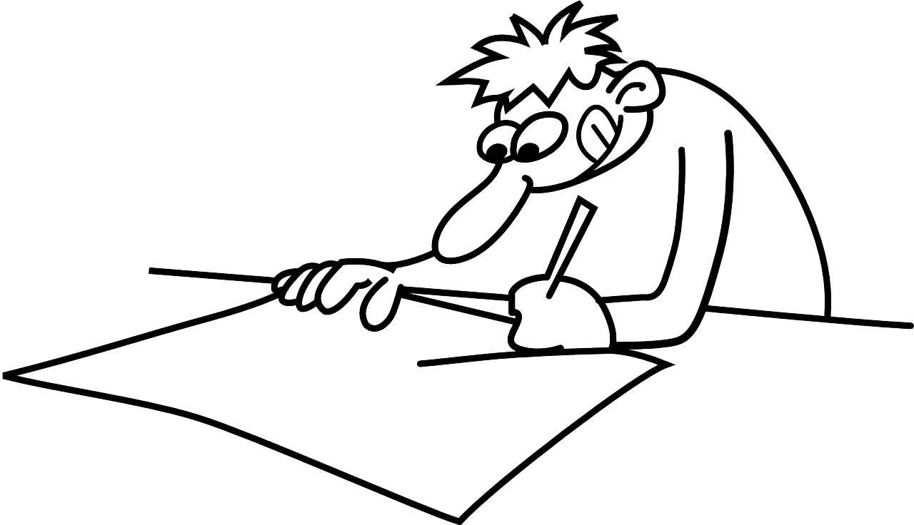
A Practical Approach to Structure

Slide 8
Act I (Roughly 20 % of the Story):
Ordinary World
Disturbance/Problem/Call to Action/Inciting Incident
Argument Opposed to Transformation
Fear/Reluctance/Refusing Call
Care Package
Trouble Brewing
Crossing the Threshold #1/Doorway of No Return #1

Slide 9
Act II (Roughly 60% of the Story):
Kick in the Shins
Tests
Mid-Point Transformation
The Mirror Moment
Pet the Dog— (i.e., an act of kindness and self-sacrifice on the part of the lead character)
Approaching the Cave
Crossing the Threshold #2/Doorway of No Return #2

Slide 10
Act III (Roughly 20% of the Story)
Mounting Forces
Climax/Lights Out
Ticking Clock
Moral Dilemma
Emotional Punch/Gimmick
Final Battle/Ordeal—Outer and/or Inner
Reversal of Reader Expectation
Transformation/Resurrection

Slide 11
Raffle Word: Structure
See handouts for detailed notes and suggested reading list.
See www.jwelliot.com/writers-resources/ for writing books and a guide to self-publishing and marketing.
www.jwelliot.com

